Slide 1
Machine intelligence and the data-driven future of science
Ketil Malde
Institute of Marine Research
Bergen, Norway
ketil.malde@imr.no
Notes:
Thank for the invitation
I am..
10 years bioinf, now machine learning
interesting to learn more about ecosystems

Slide 2
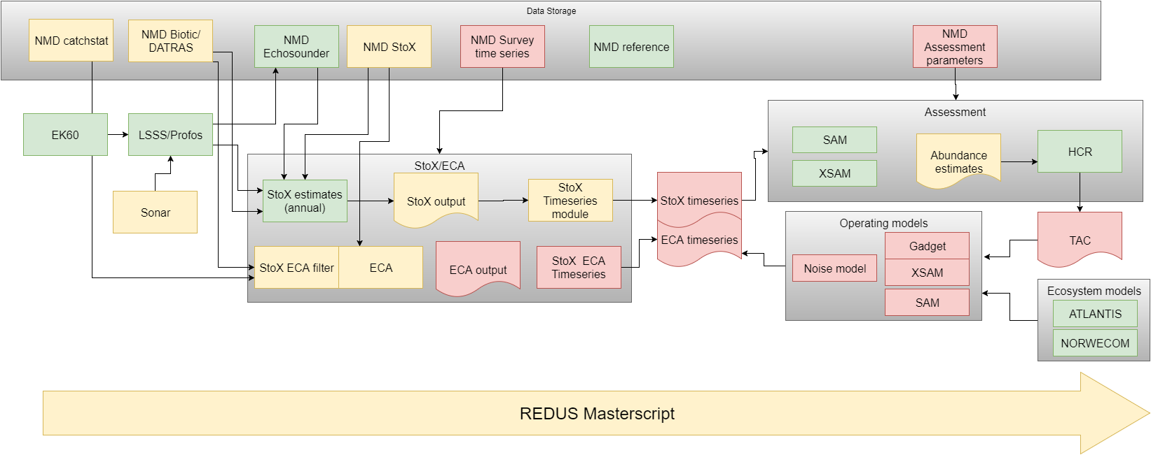
A management advice model
Notes:
What we do at the IMR: science and advice
our data model for advice - it is complex
- Data collection
- Human interpretation
- Automated/computerized processes
- Simulations

Slide 3
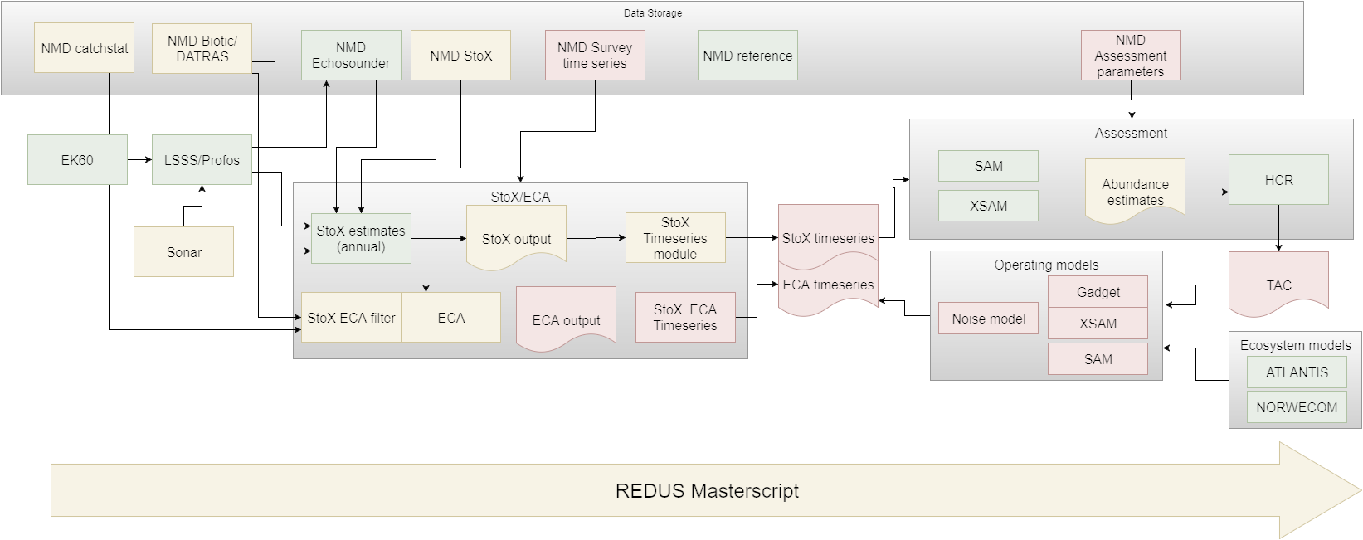
A simplified model
Notes:
Simplified model:
Data flows in from the left and ends up in knowledge (management advice) on the right
Data is important, it starts with the data.

Slide 4
Oceans of data
Notes:
Even in a modelling community - or especially?
Data from observations in the lab and in the field are crucial - our inputs.
Fortunate: Technology has progressed:
sensor tech, autonomous platforms, robots
Data volumes have exploded.
Interesting times.

Slide 5
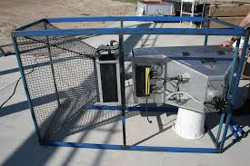
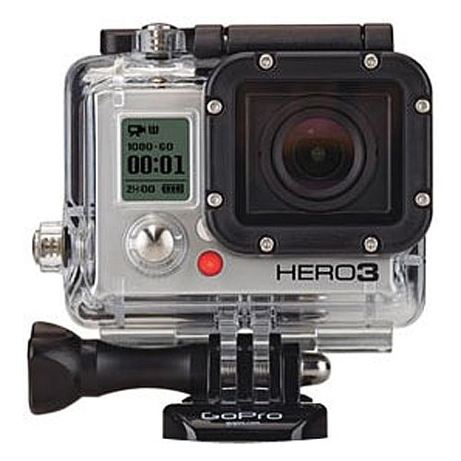
Images
Notes:
Vaki RiverWatcher, Gopro,
Deep Vision - trawl cam.
14 days with DV: over 3 million images
Not shown: drone photos, satellite imagery.
Copernicus satellite: 4 TB per day.

Slide 6
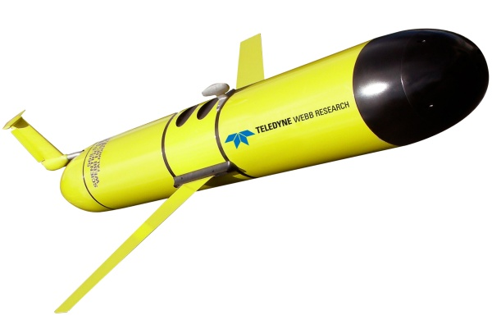
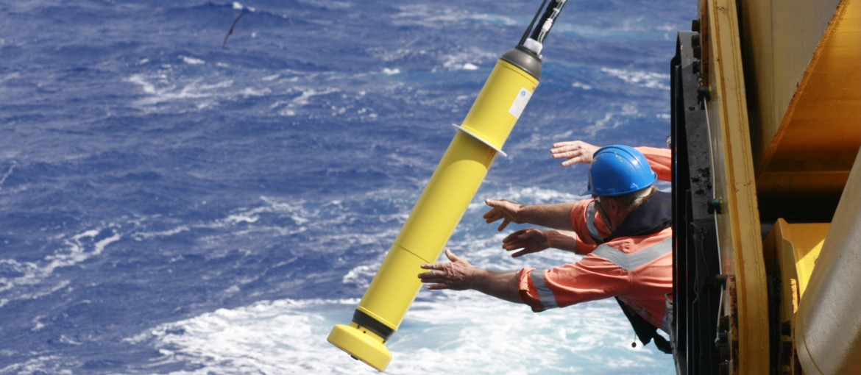
Floats, ROVs, and AUVs (oh my!)
Notes:
ARGO costs 1:10000 of a ship
one in the water every day, within budget.

Slide 7
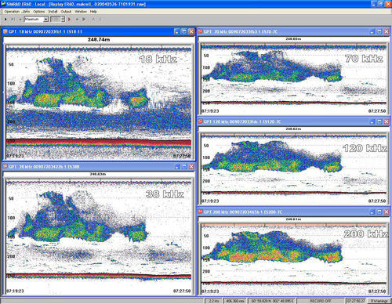
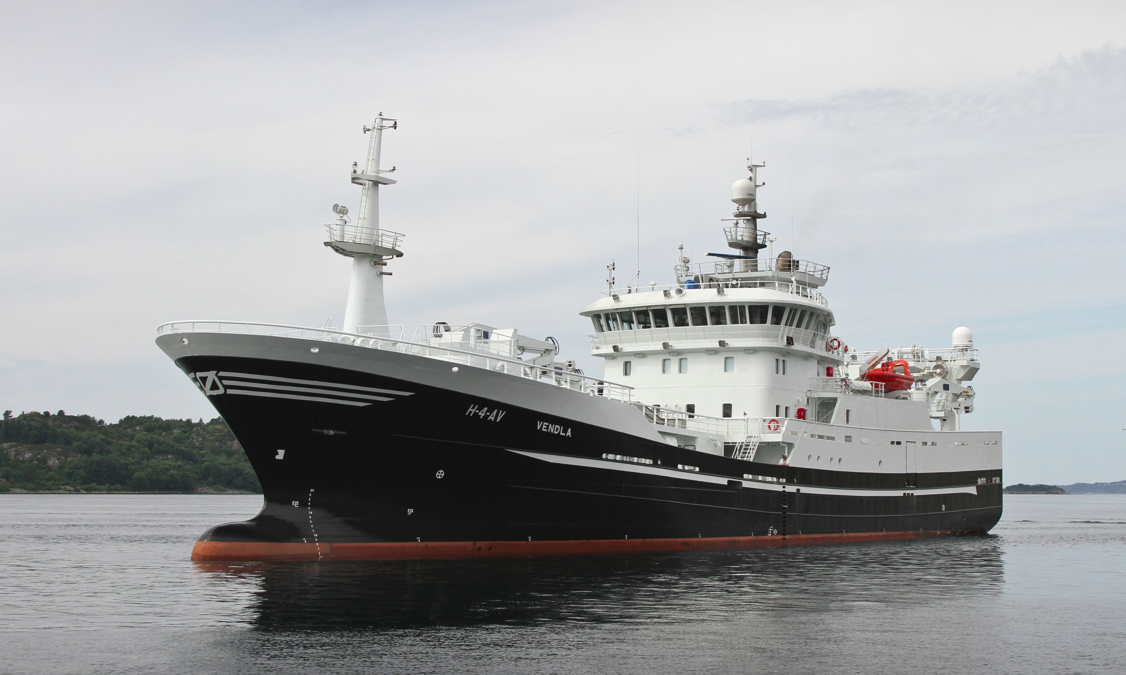
Acoustics
Notes:
Increased complexity of data
- multi freq
-broadband

Slide 8
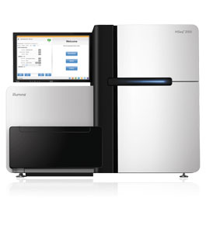
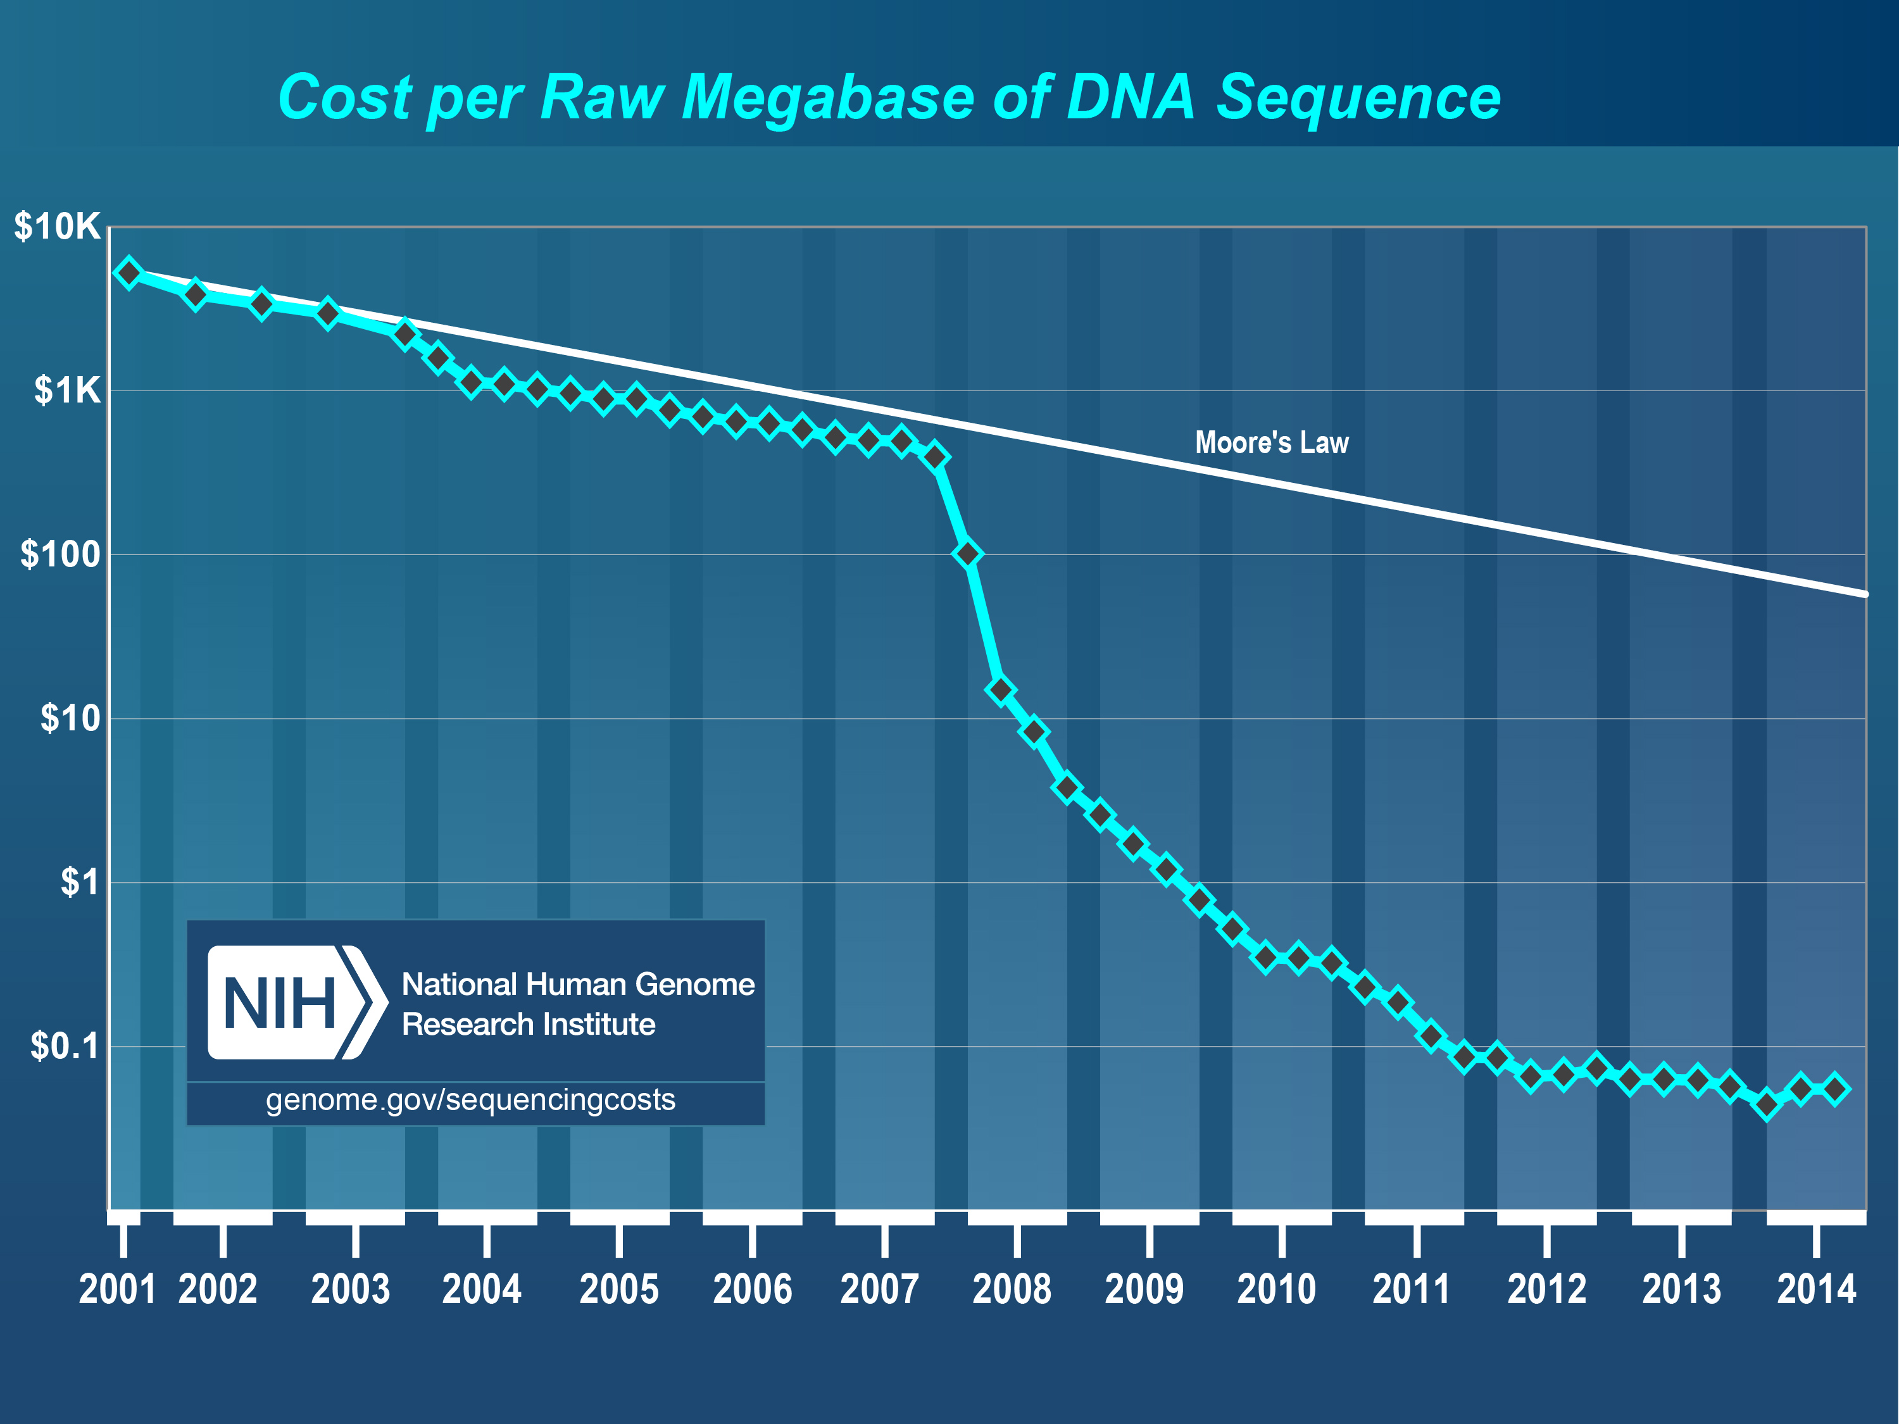
Molecular methods
Notes:
Started out ten years ago: 20Mb
Now: 2TB
Factor: 100 000 (moore: double every two years, us: factor of ten.)

Slide 9
The Analysis Bottleneck
Notes:
Technology brings challenges:
- volume
- complexity
- quality
Analysis hasn't kept up. (DV: 14 days, 3M images, 3 seconds each image - two years worth of labor)
While tech is great (SR-71?), value of unanal

Slide 10
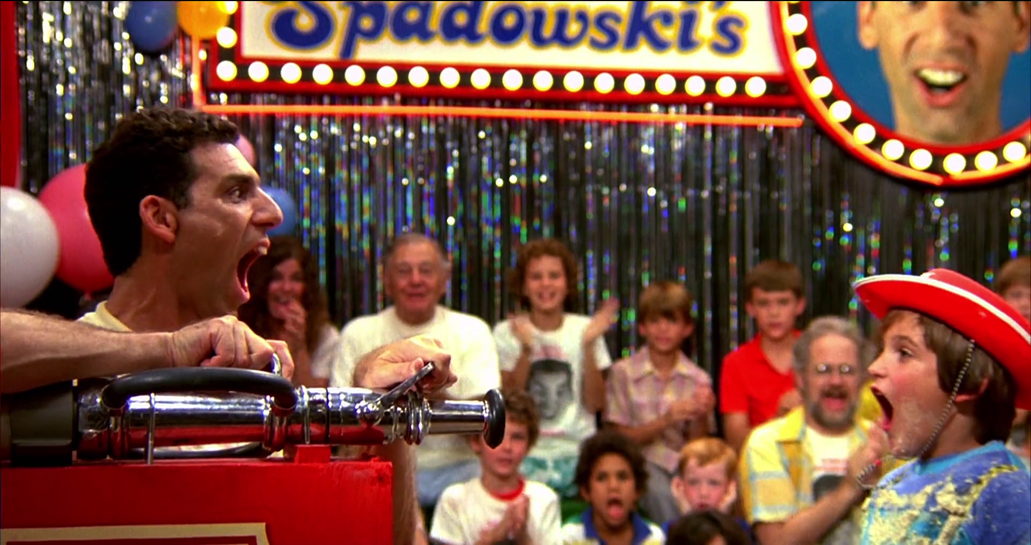
Can we drink from the firehose?
Notes:
Current situation is like this.

Slide 11
The Deep Learning Revolution

Slide 12
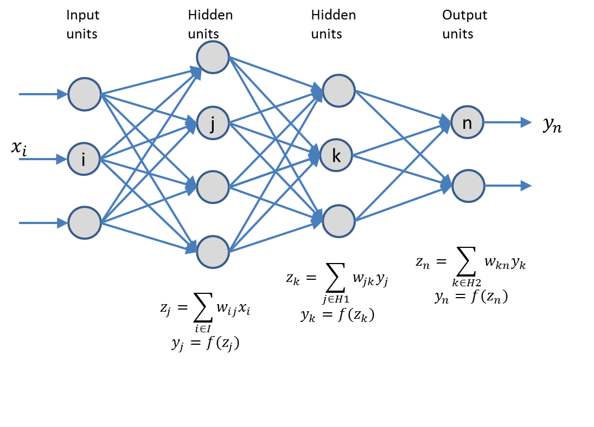
What is machine learning?
Notes:
Specify general architecture, parameters are trained
- need lots of data with correct classification
Adjust parameters gradually to reduce error
Neural network. Feed forward. Popular in the 80s.

Slide 13
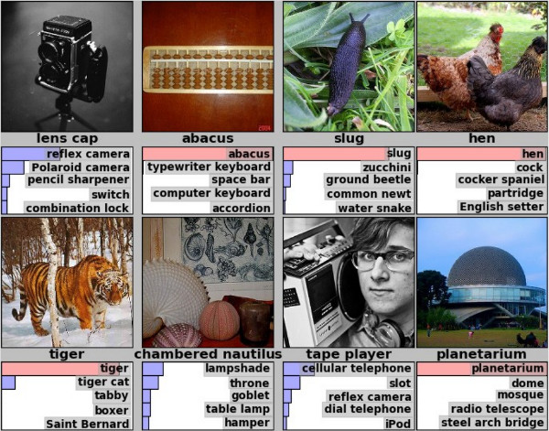
The ImageNet challenge
Notes:
Kriszhevsky et al 2012
halved error rates.
Difficult problem! One of the things humans do intuitively, but machines can't.

Slide 14
The secret sauce: deep convolutional networks
Notes:
Previously: classify on manually extracted features
- lower layers identify primitive features
- middle layers identify patterns
- top layers identify abstract classes
Important: this is general! Manual feature extraction is fragile.

Slide 15
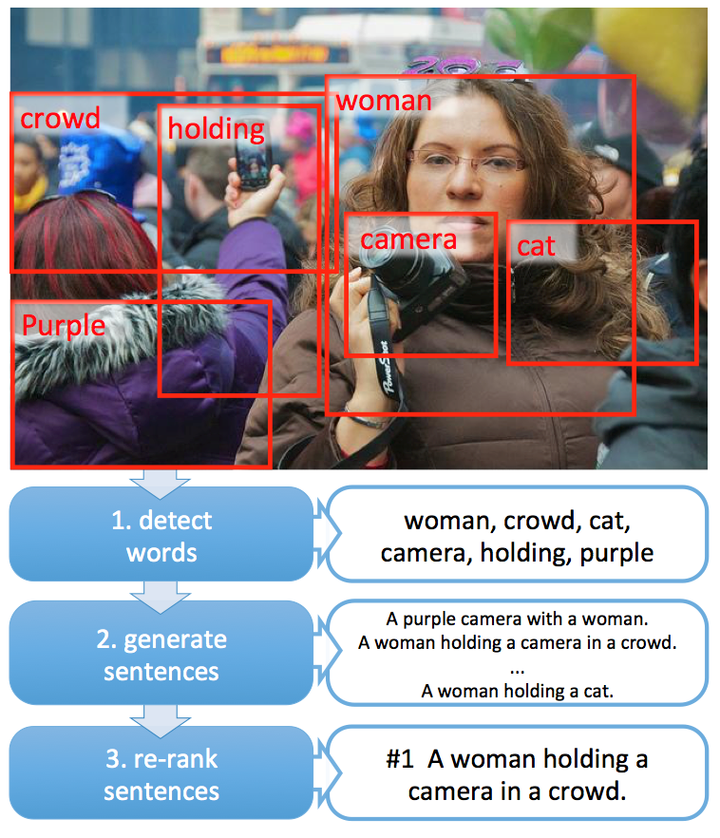
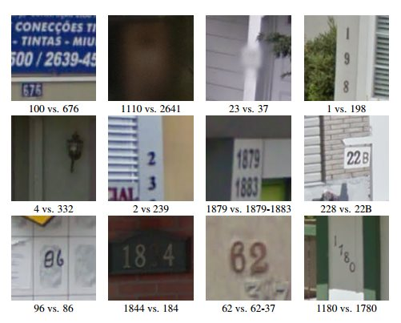
Example applications

Slide 16
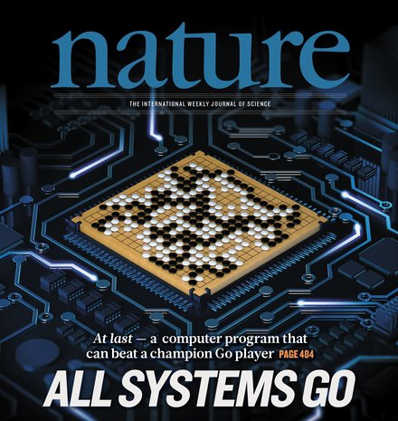
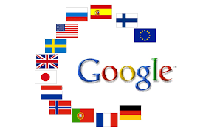
But not just images!
Notes:
AlphaGO
Google translate

Slide 17
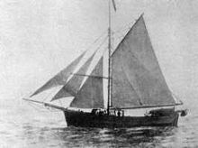
Revolution - why now?
20 years in the making:
important algorithmic advances
increase in computer power
large data sets for training
Notes:
Idle as a painted ship, upon a painted ocean

Slide 18
Data, data, everywhere
Notes:
We now have the data, methods, computers
Can we use ML to mitigate the AB?

Slide 19
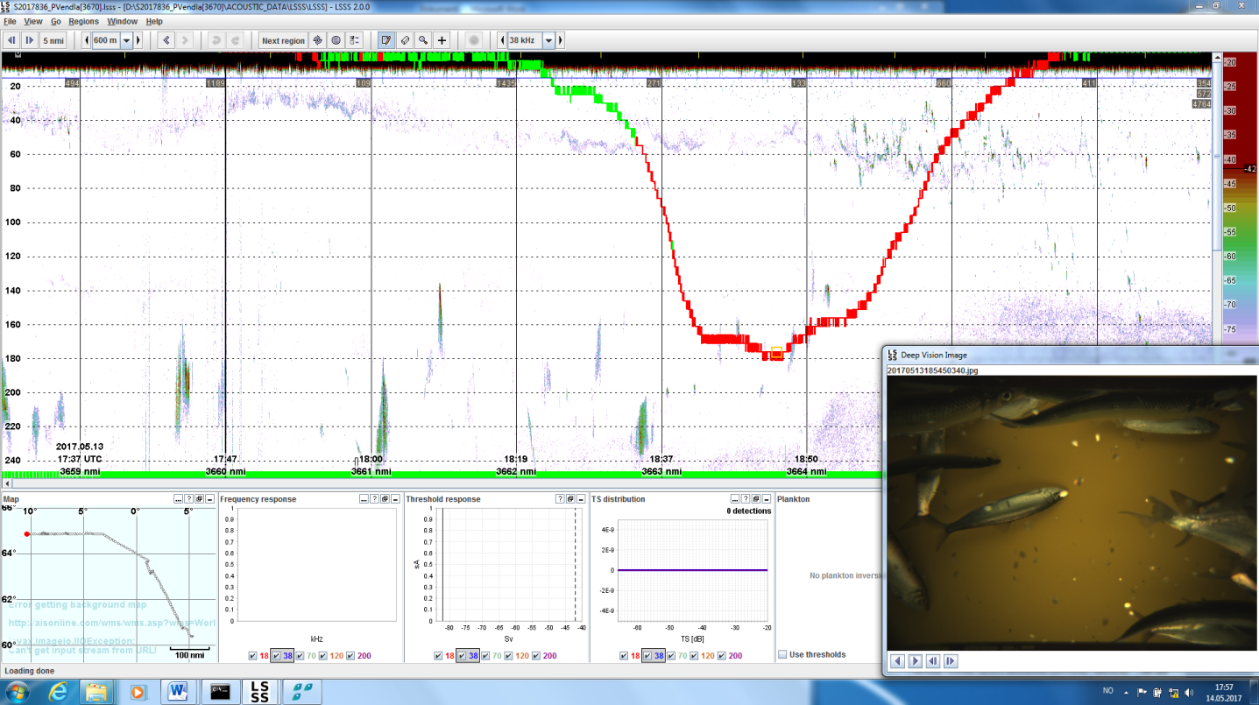
Deep Vision and echosounder data
Notes:
LSSS with DV data
1. Build classifier to recognize fish from images
2. Use it to train classifier to interpret ES data
Rinse, repeat.
(simulate data set for 1.)

Slide 20
Our data-driven future
Notes:
Assuming we can solve the analysis bottleneck,
what will happen?

Slide 21
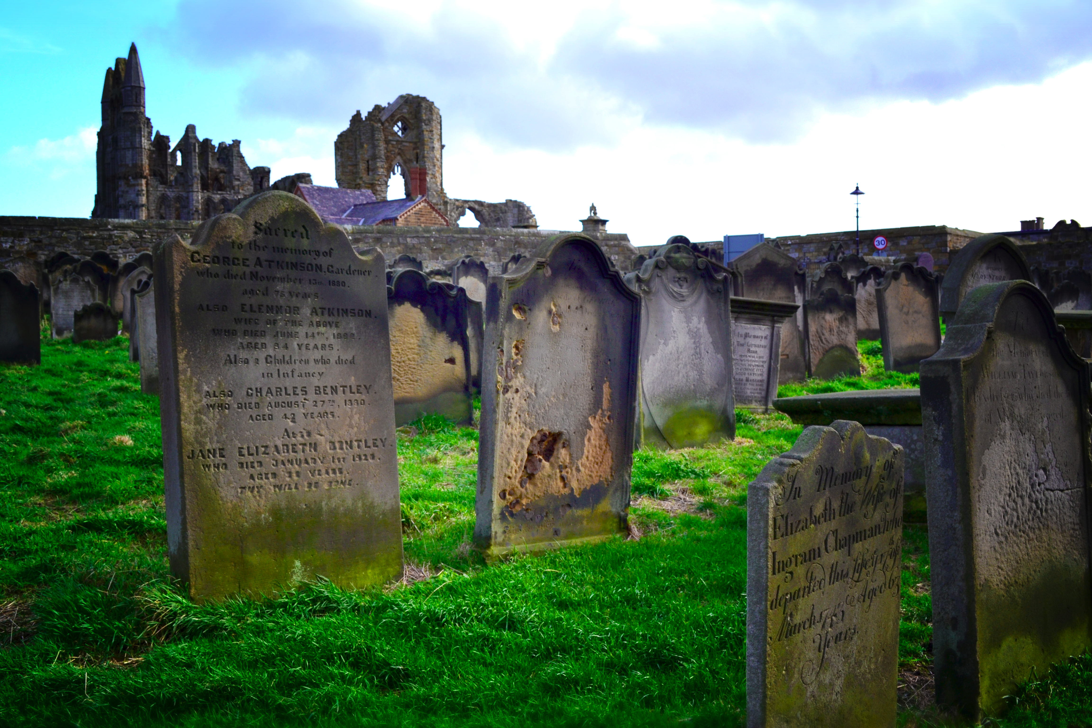
Lower cost - higher value!
Make data great again!
Notes:
Obviously: lower cost of analysis
= higher value of data
Value of data that never is analyzed?
(less than zero)
- more reliable/consistent analysis
- benefit from improved technology
Blossoming garden - not a data graveyard

Slide 22
Automating the data flow
Notes:
Eliminating the human curation step - whole pipeline can be automated.
- reproducible
- experimentible
Are we using our resources for data collection sensibly?
There is nothing so useless as doing efficiently that which should not be done at all.
Peter Drucker.

Slide 23
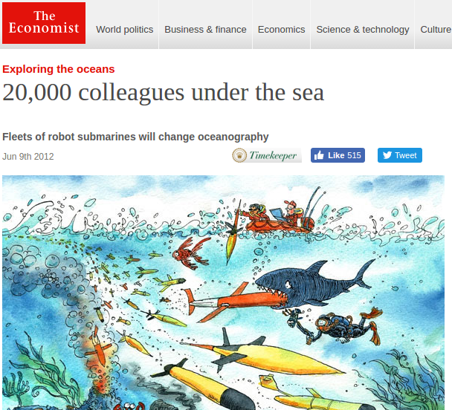
Even more data
Notes:
2012 - same year as Krizhevsky
20K - but *under* the sea. Pushing out data.
What point when nobody is there to analyze?
When the analysis bottleneck is eliminated.
And when we do?
- fishing fleet: observe every single fish?
- (today: one river. tomorrow: all of them)
This can change everything.

Slide 24
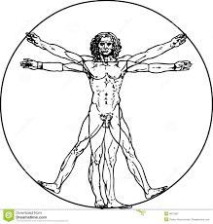
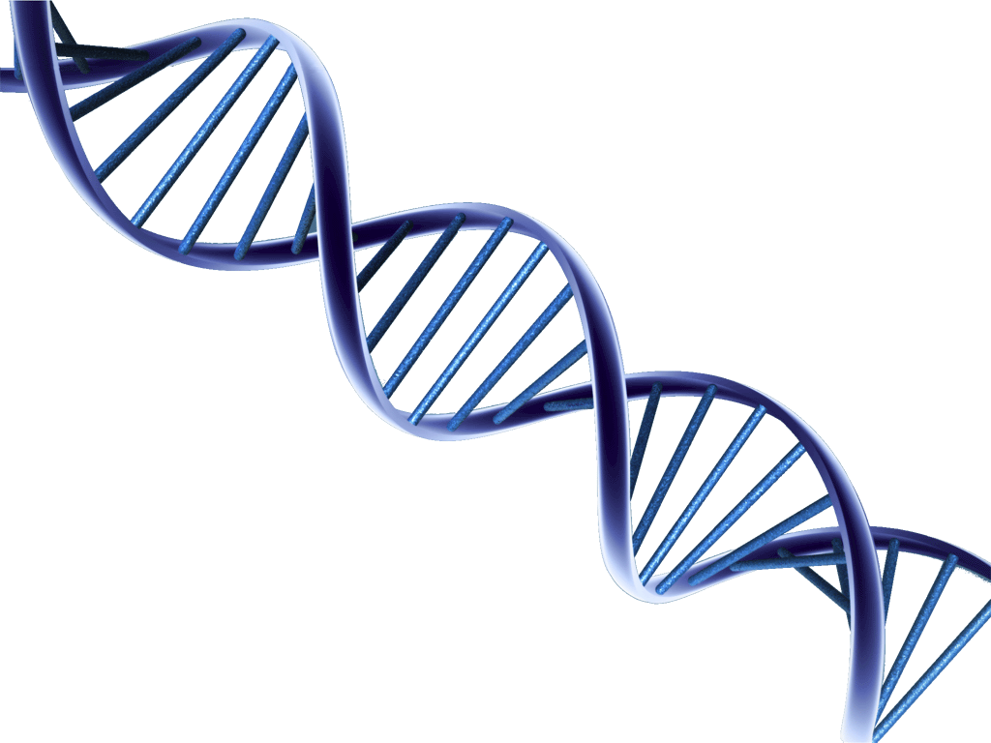
To boldly go...
Complex adaptive systems?
Notes:
Some things possible in theory
As a bioinformatician: DNA -> organism
Simple in principle, and tons of data, but
- many parts, interactions, non-linearities, feedback
(sounds familiar?)
I don't know if we can solve this problem. .
But I think we should give it a try.

Slide 25
Summary
The analysis bottleneck
limits data usefulness
Machine learning methods
can automate analysis
This will have
profound consequences

Slide 26
Thanks!
Notes:
Thank
- Colleagues and collaborators
- Organizers for having me here
- You for listening so patiently.

